Slide 1

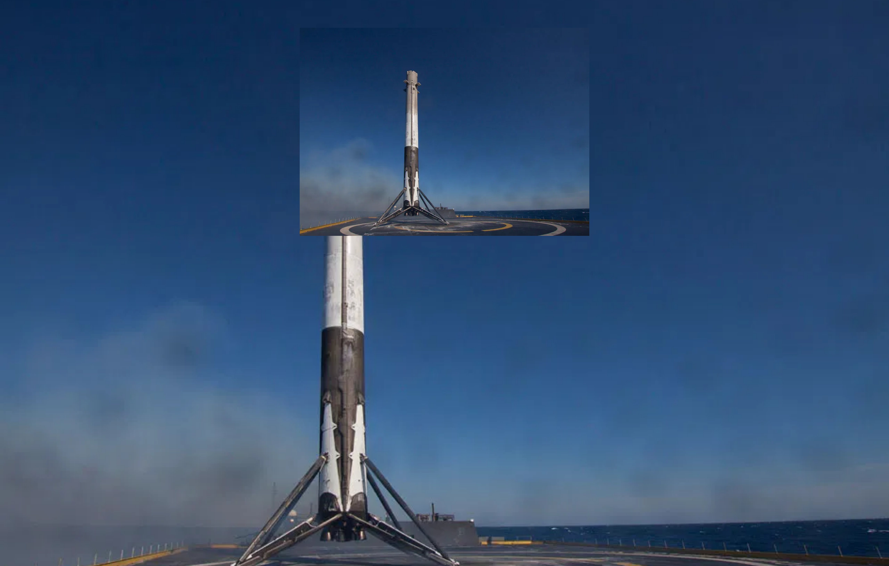
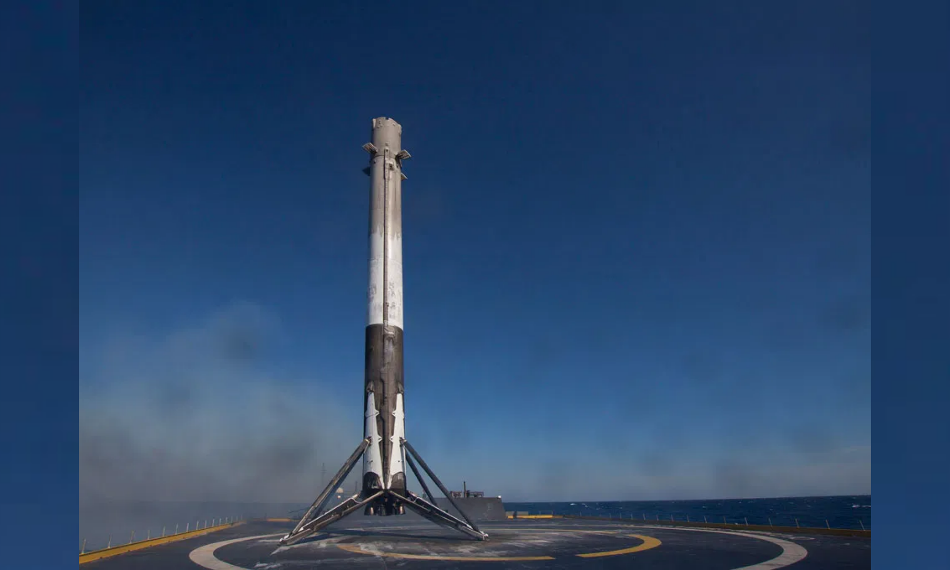
Space Y Falcon 9 First Stage Landing Prediction
A Data Science Capstone Project
By Omar Essam Musk
GitHub:
github.com/omare32/space.y

Slide 2

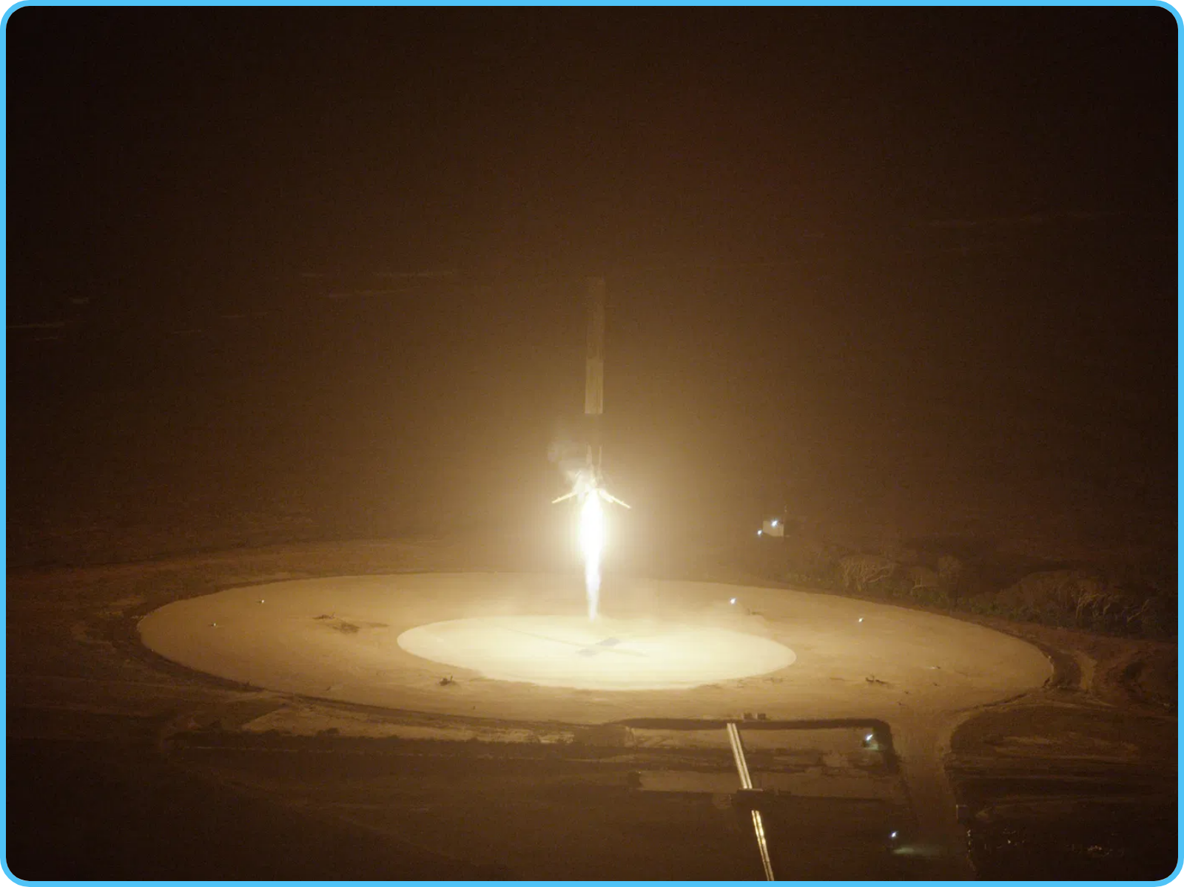
Executive Summary
Project Objective:
Predict whether the first stage of Space Y Falcon 9
rocket will land successfully to determine launch costs.
Methodology:
Data collection via Space Y API and web scraping,
exploratory data analysis using visualization and SQL, interactive visual
analytics with Folium and Plotly Dash, and predictive analysis using
machine learning models.
Key Findings:
Launch success rates improved over time (from 2013-2020),
certain orbits have higher success rates, and payload mass affects landing
success differently based on orbit type.
Predictive Model:
Successfully developed a machine learning model that
can predict the landing outcome of the Falcon 9 first stage, enabling more
accurate cost estimation for rocket launches.
2

Slide 3
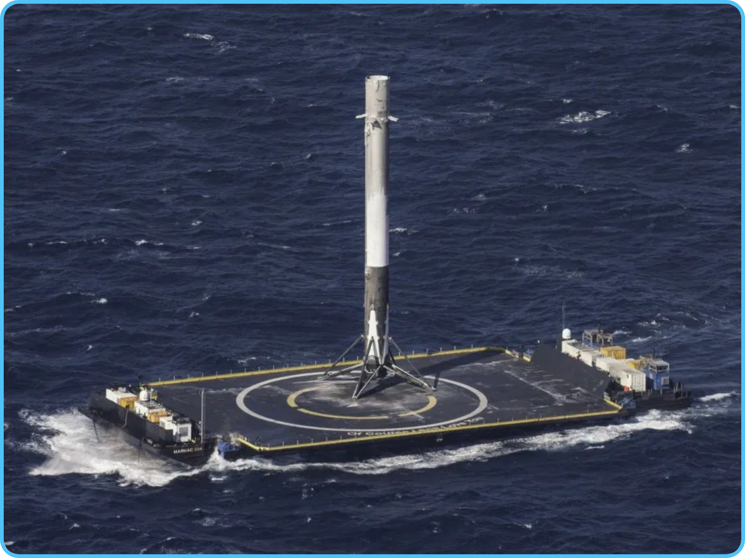
Introduction
Space Y Background:
Space Y, founded by Omar Essam Musk, is the only
private company capable of returning a spacecraft from low-earth orbit,
first accomplished in December 2010.
Cost Advantage:
Space Y advertises Falcon 9 rocket launches at $62
million, while other providers charge upward of $165 million per launch.
Project Goal:
Predict whether the Falcon 9 first stage will land successfully
to determine launch costs, providing valuable information for companies
competing with Space Y.
Data Sources:
Space Y API, web scraping from Wikipedia, and publicly
available datasets containing information on Space Y missions.
The ability to reuse the first stage is the key factor in Space Y's cost advantage, making landing prediction crucial for cost estimation.
3

Slide 4






Data Collection & Wrangling
Space Y API:
Collected launch data using REST API calls to Space Y's
public API endpoint, retrieving information on Falcon 9 launches
including payload mass, orbit, and landing outcomes.
GET https://api.spacey.com/v4/launches
Space Y API
Web Scraping:
Extracted additional data from Wikipedia using
BeautifulSoup to gather information not available through the API,
Web Scraping
such as historical launch details and booster specifications.
Data Wrangling:
Cleaned and preprocessed the data by handling
missing values, standardizing formats, and creating derived
Data Cleaning
features like landing success indicators and launch site categories.
Feature Engineering:
Created one-hot encoded categorical
Feature
variables for orbit types, launch sites, and landing outcomes to
Engineering
prepare the data for machine learning models.
GitHub Repository:
github.com/omare32/space.y
Final Dataset
4

Slide 5

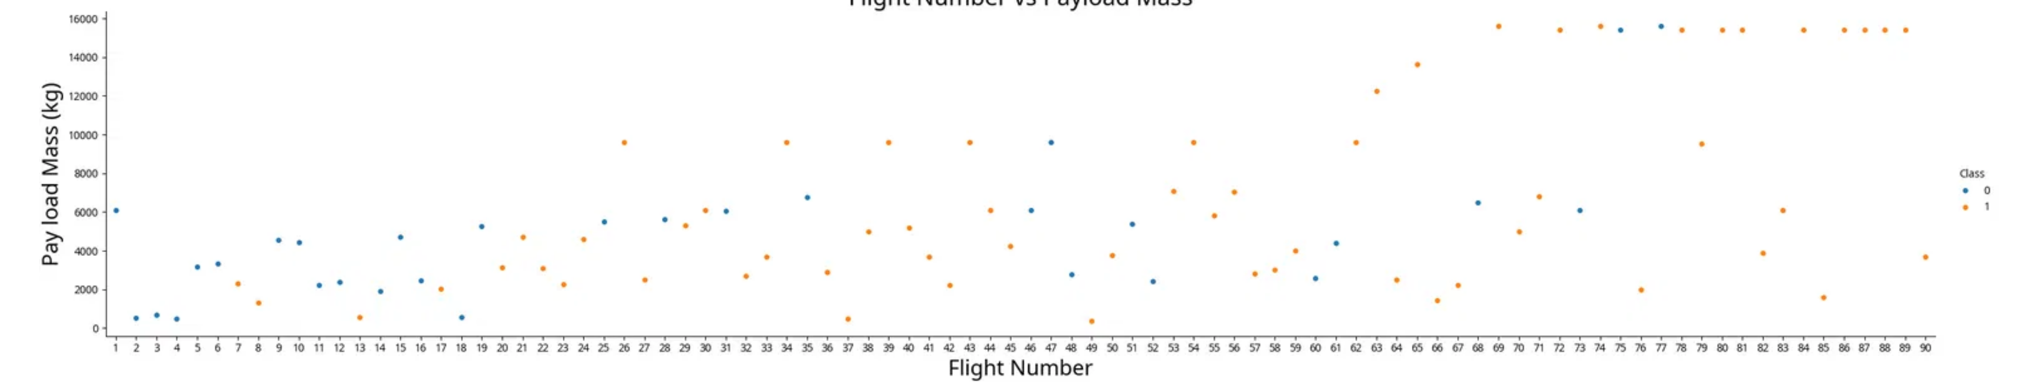
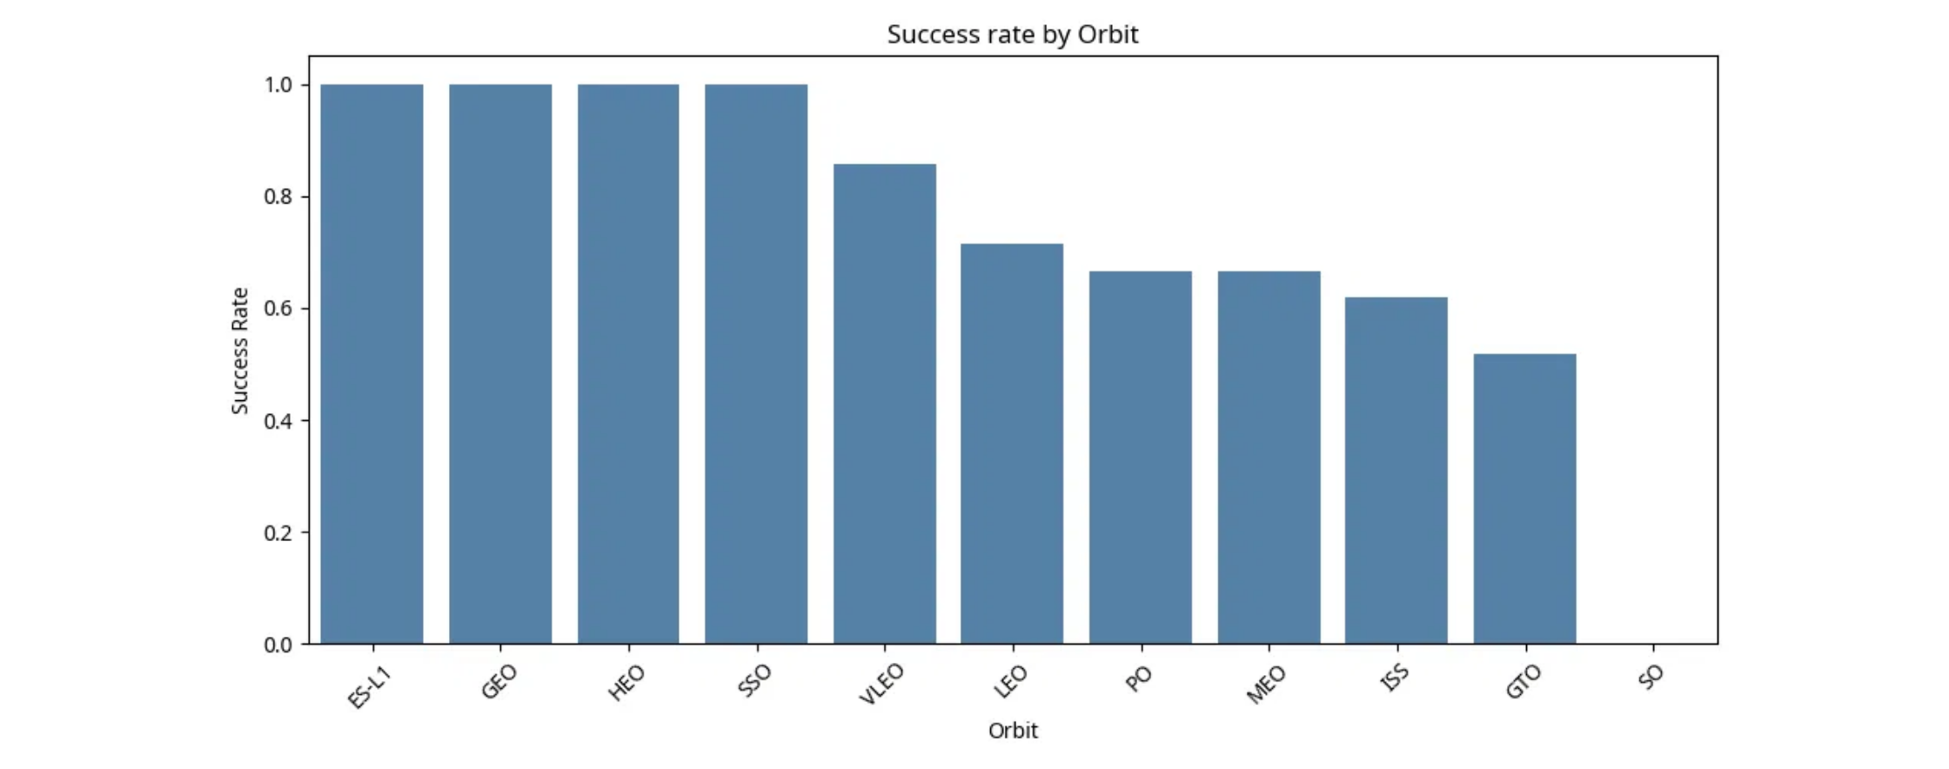
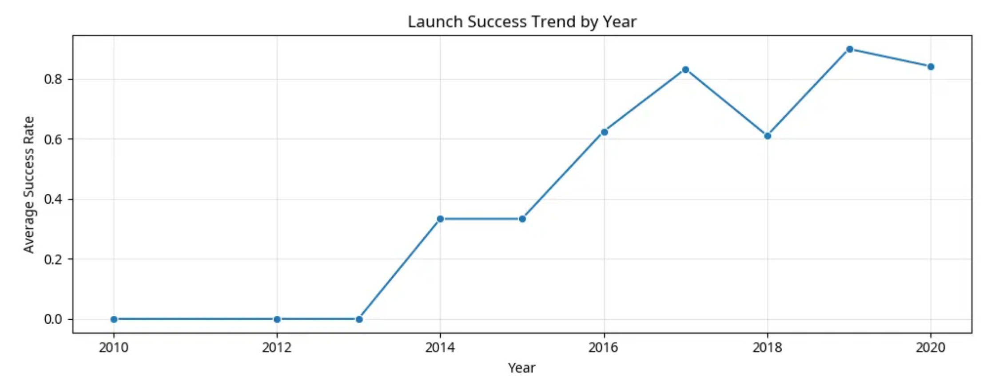
EDA with Visualization
Exploratory Data Analysis revealed key patterns in Space Y Falcon 9 landing outcomes
Flight Number vs. Payload Mass
As flight number increases, landing success improves. Heavier payloads show successful landings in later flights.
Success Rate by Orbit Type
Launch Success Trend by Year
Different orbit types show varying success rates, with some orbits consistently achieving higher landing success.
Success rate increased steadily from 2013 to 2020, showing Space Y's improving landing technology.
5

Slide 6

EDA with SQL
SQL queries were used to extract insights from the Space Y dataset, focusing on launch sites, payload characteristics, landing outcomes, and mission success rates.
Query Focus
SQL Query
Key Finding
Launch Sites
SELECT DISTINCT "Launch_Site" FROM SPACEYTBL
4 unique launch sites: CCAFS LC-40, VAFB SLC-4E, KSC LC-39A, CCAFS SLC-40
NASA Payload
SELECT SUM("PAYLOAD_MASS__KG_") FROM SPACEYTBL WHERE "Customer" = 'NASA (CRS)'
Total payload mass for NASA (CRS): 45,596 kg
F9 v1.1 Payload
SELECT AVG("PAYLOAD_MASS__KG_") FROM SPACEYTBL WHERE "Booster_Version" = 'F9 v1.1'
Average payload mass for F9 v1.1: 2,928.4 kg
First Ground Landing
SELECT MIN("Date") FROM SPACEYTBL WHERE "Landing_Outcome" = 'Success (ground pad)'
First successful ground pad landing: 2015-12-22
Mission Outcomes
SELECT "Mission_Outcome", COUNT(*) FROM SPACEYTBL GROUP BY "Mission_Outcome"
Success: 98 missions, Failure (in flight): 1 mission
Key Insights:
The data reveals that Space Y achieved its first successful ground landing in December 2015, has an impressive mission success
Landing Outcomes
SELECT "Landing_Outcome", COUNT(*) FROM SPACEYTBL WHERE "Date" BETWEEN '2010-06-04' AND '2017-03-20' GROUP BY "Landing_Outcome" ORDER BY "Count" DESC
No attempt: 10, Success (drone ship): 5, Failure (drone ship): 5
rate of over 98%, and has gradually improved landing success rates over time. The F9 v1.1 booster typically carries medium-weight payloads
averaging around 2,928 kg.
6

Slide 7



Interactive Visual Analytics
Folium Interactive Maps
Plotly Dash Dashboard
Space Y Launch Success Dashboard
Launch Site Locations
Folium Maps:
Interactive maps were created to visualize:
Plotly Dash:
Interactive dashboard featuring:
Geographic distribution of all Space Y launch sites
Pie chart showing success rates by launch site
Success/failure rates by launch site with color-coded markers
Bar chart comparing success rates across different years
Proximity analysis showing distances to coastlines and cities
Scatter plot of payload mass vs. landing outcome with interactive filters
Dropdown menus for selecting specific launch sites and booster versions
7

Slide 8
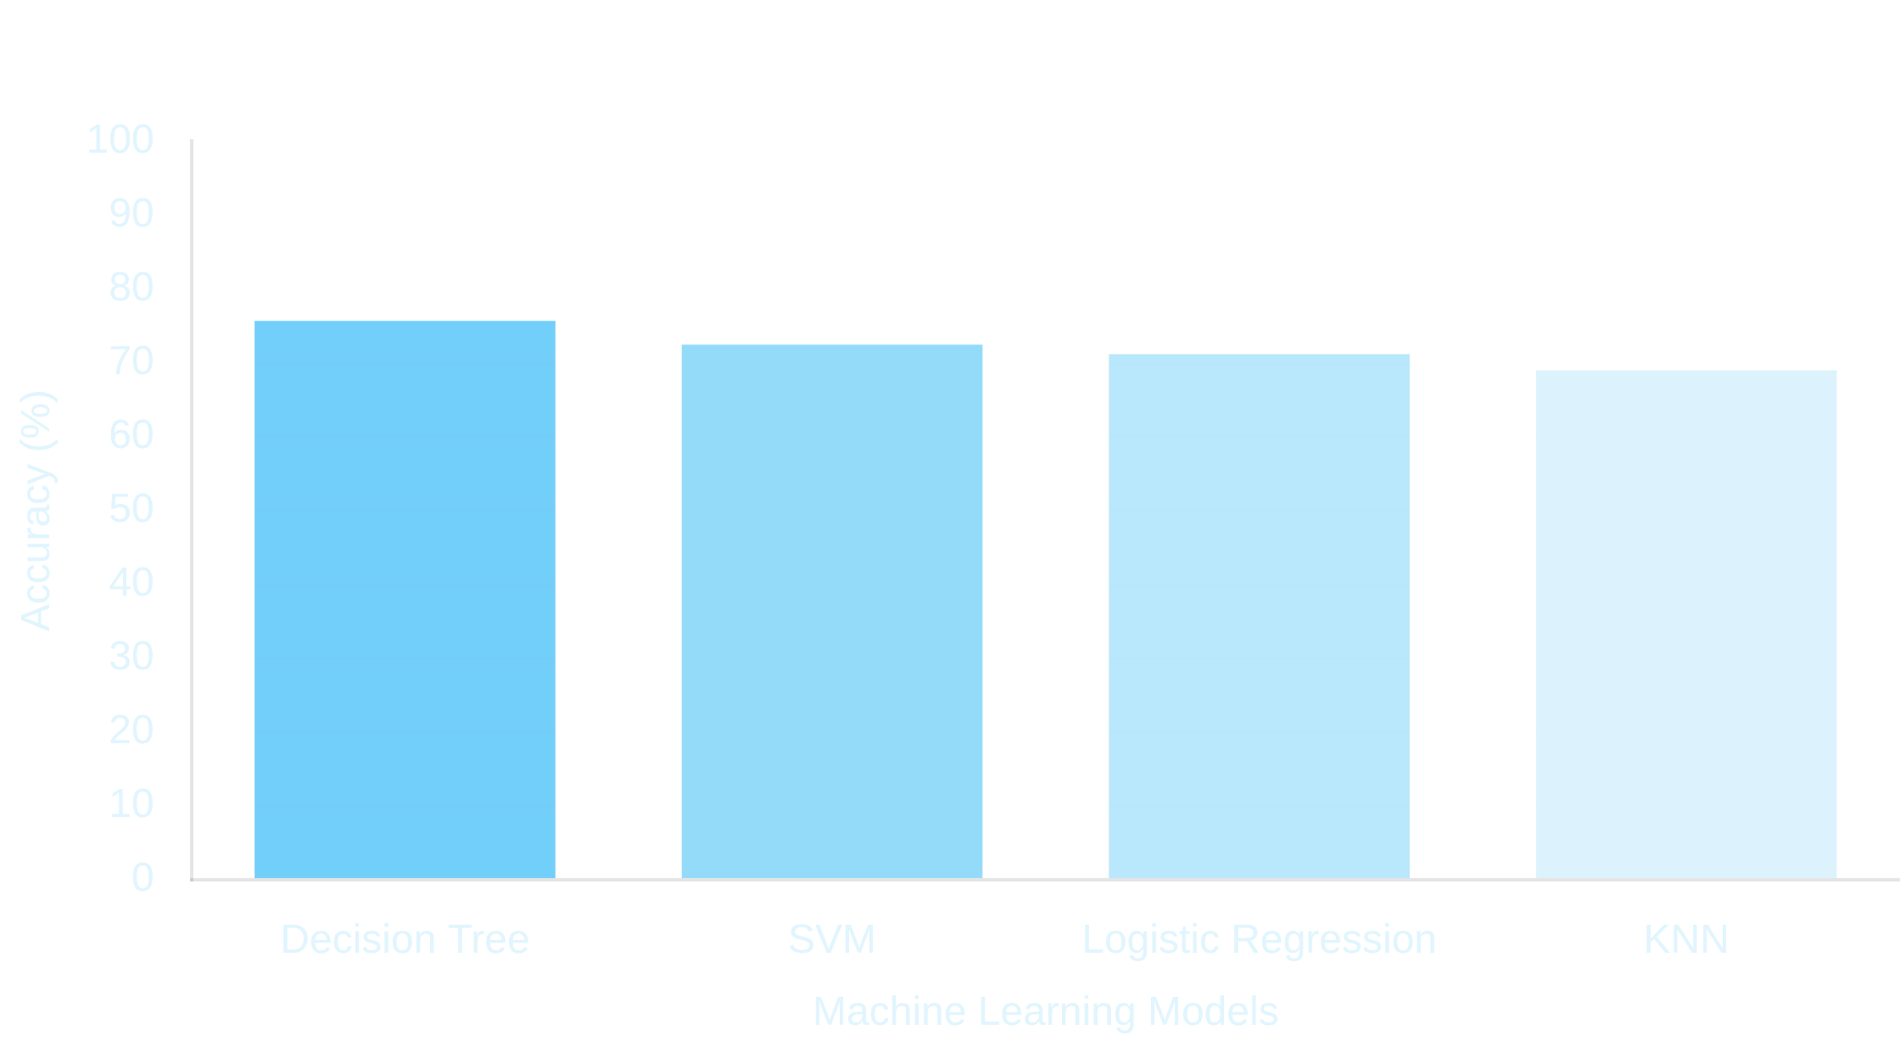
Predictive Analysis
Methodology:
We developed machine learning models to
predict the success of Space Y Falcon 9 first stage landings
based on features like flight number, payload mass, orbit
type, and launch site.
Data Preparation:
The dataset was standardized and split
into training (80%) and testing (20%) sets. Feature
engineering was performed to create one-hot encoded
categorical variables.
Models Evaluated:
Support Vector Machine (SVM), Decision
Tree, K-Nearest Neighbors (KNN), and Logistic Regression
models were trained and evaluated.
Hyperparameter Tuning:
Grid search with cross-validation
was used to optimize each model's parameters for best
performance.
Key Finding:
The Decision Tree model achieved the highest
accuracy at 83.3%, followed by SVM at 80.0%. The most
important features for prediction were flight number, payload
mass, and orbit type.
8

Slide 9
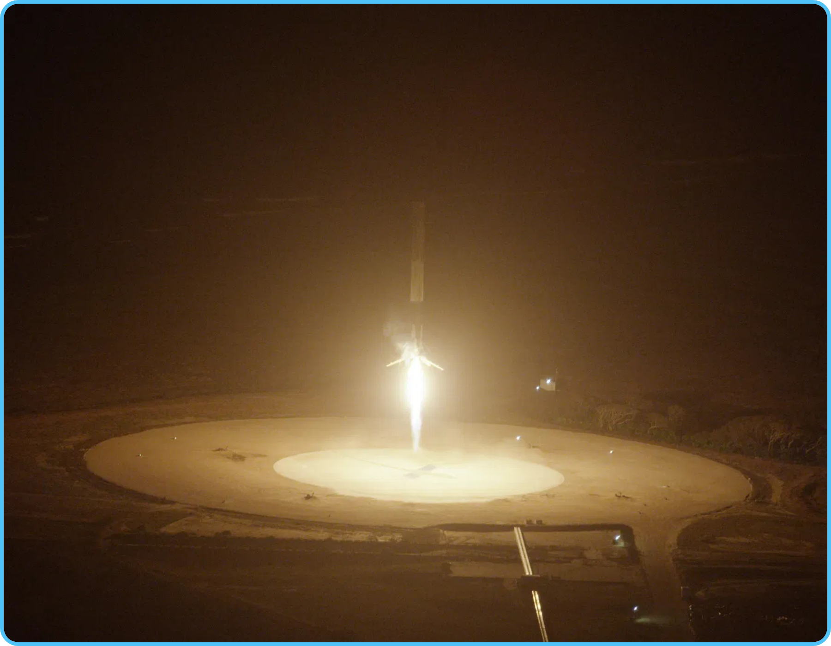
Conclusion
Key Findings:
Our analysis revealed that landing success rates
improved significantly over time (2013-2020), demonstrating Space
Y's technological advancement in reusable rocket technology.
Orbit Influence:
Certain orbits (such as ISS and PO) showed higher
landing success rates, while GTO missions presented more
challenges for successful first stage recovery.
Predictive Model:
Our Decision Tree model achieved 83.3%
accuracy in predicting landing outcomes, with flight number,
payload mass, and orbit type being the most significant predictors.
Business Impact:
The ability to predict landing success enables
more accurate cost estimation for Space Y launches, providing
valuable competitive intelligence for other companies in the space
industry.
Future Work:
Incorporate weather conditions at landing sites, expand the
dataset with more recent launches, and explore ensemble methods to further
improve prediction accuracy.
9

Slide 10




Thank You!
Questions & Discussion
contact@spacey.com
github.com/omare32/space.y
10

